Slide 1
B20 and T20 Turkey on improving global infrastructure investments
Ussal Sahbaz
China-Australia Global Issues Dialogue
Shanghai, August 14, 2015
tepav
The Economic Policy Research Foundation of Turkey

Slide 2
Agenda
G20 Troika and infrastructure
  Australia
  Turkey
Business 20 and Think 20 Turkey in infrastructure
  Recommendations to catalyze more private investment into infrastructure
Chinese G20 Presidency
  Agenda suggestions

Slide 3
Australian focus
Refocusing the G20 agenda
  2% additional growth target by 2018
Growth plans
  27% of the 2% growth target comes from infrastructure
Special focus on infrastructure
  Institution building: Global Infrastructure Hub

Slide 4
Turkey
Focus: 3Is
  Implementation, investment, inclusiveness
Country-specific investment strategies
  Berlin IIWG meeting to finalize
  Infrastructure +
  Targets?
Infrastructure eco-system
  Securitization
  PPPs: capacity building and functioning models
  Islamic finance
Global infrastructure development is important for Turkey
  Turkey has the second highest number of companies among top-250 contractors list in the world (after China)

Slide 5


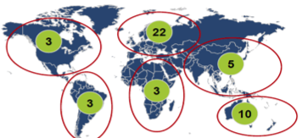


B20 Turkey I and I Taskforce
(content lead: TEPAV)
Ferit Şahenk
Chairman of Doğuş holding
Fu Chengyu
Former Chairman of Sinopec Group
Co-chairs:
Krill Dmitriev (CEO of Russian Direct Investment Fund), Marcus Wallenberg (Chairman of Skandinaviska Enskilda Banken), Nabil Habayeb (President & CEO MENAT GE), David Thodey (CEO of Telstra Corporation), Francesco Starace (CEO and General Manager of ENEL), Zhi Ying (Vice President & Chief Brand Officer of Tsinghua Tongfang Co., Ltd)
Taskforce Members
21
95
55
3
6
7
Knowledge Partner
Business Network

Slide 6





Recommendation Development Workstream Timeline
Dec’14
Jan’15
Feb’15
Mar’15
Apr’15
May15
Jun’15
Jul’15
Aug’15
Sep’15
Oct’15
Nov’15
G20/B20 event in Davos
Joint taskforce meeting IMF/ WB in Washington DC
Joint taskforce meeting OECD in Paris
B20 conference
in Ankara
Taskforce kick-off in Istanbul
G20 summit
in Antalya
15
22-23
9-10
16-17
2
3-5
14-15
Member registration
Regional consultation meetings
Present to G20 governments
Induction reports
1st Policy Paper
(Long list of
recommendations)
2nd Policy Paper (Short list of recommendations)
Final Policy Papers
B20 Policy Communique

Slide 7
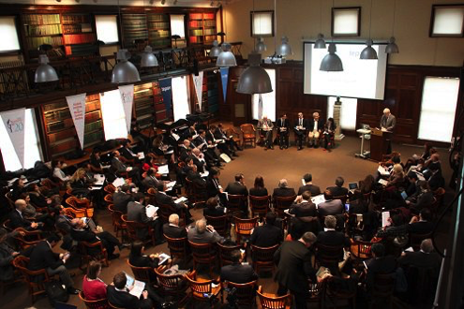
Think 20 Turkey (chaired by TEPAV)
Meetings on infrastructure
  Istanbul (February)
  Izmir / Bodrum (June)
  Addis Ababa (July)
Additional focus
  LIDCs
  Sustainability
www.t20turkey.org

Slide 8
Infrastructure project cycle and supporting ecosystem
Question: How to catalyze private money into infrastructure investments?
Project preparation and evaluation
Procurement and approvals
Execution / financing
Asset management
National infrastructure investment policies
Sustainability

Slide 9
Project preparation and evaluation
Project preparation and evaluation
Procurement and approvals
Execution / financing
Asset management
Standard approach
  a standard project-structuring approach to help investors evaluate and finance projects by coordinating stakeholders
  Global Infrastructure Hub
Engaging business at the earliest stage possible
  National infrastructure project preparation facilities
  Venture funds for feasibility studies
Technical support / advisory
  Global Infrastructure Facility / World Bank

Slide 10
Procurement and approvals
Project preparation and evaluation
Procurement and approvals
Execution / financing
Asset management
Common standards and a digital platform for procurement
  best value v low cost: project development costs can vary by a factor of two to three across countries
  Global Infrastructure Hub
Model approval paths for permits
  Global Infrastructure Hub

Slide 11
Execution / financing
Project preparation and evaluation
Procurement and approvals
Execution / financing
Asset management
Avoiding unintended consequences of new financial regulations on infrastructure investments
  BASEL III (Banks): do not penalize infrastructure project debt by requiring higher capital ratios, although infrastructure debt is less risky than long term corporate debt
  SOLVENCY II (insurance / EU)
Incorporating sustainability metrics into financing
  Institutional investors to measure and report carbon exposure of their portfolios (France and UK)

Slide 12
Asset management / market making
Project preparation and evaluation
Procurement and approvals
Execution / financing
Asset management
Standardize and harmonize regulations of security exchanges
Add liquidity to the markets by issuing equity / debt from infrastructure assets
  Governments as market-makers
  MDBs
Support enhancement of political risk insurance mechanisms
  MDBs

Slide 13
National infrastructure investment policies
Project preparation and evaluation
Procurement and approvals
Execution / financing
Asset management
National infrastructure investment policies
National investment strategies and targets
  Sustainability targets
Greenfield project pipelines
  Public and private
Brownfield asset optimization (pipeline)
Institutions
  Planning and execution

Slide 14
China?
Focusing on a limited number of projects to tackle cross-country connectivity bottlenecks
  One belt one road?
Enhancing co-ordination between existing national and multilateral vehicles
  Global Infrastructure Facility
  New initiatives such as Power 50 (AfDB)
Emerging solutions
  Off-grid renewables for access in LIDCs

